Slide 1

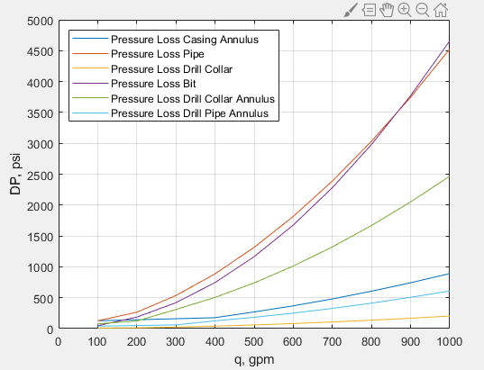
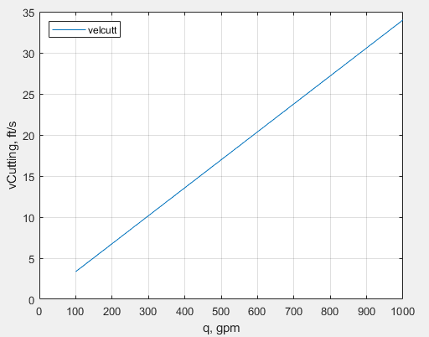
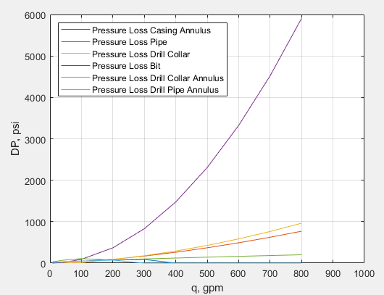
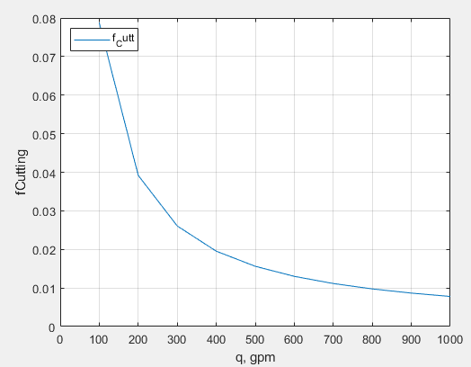
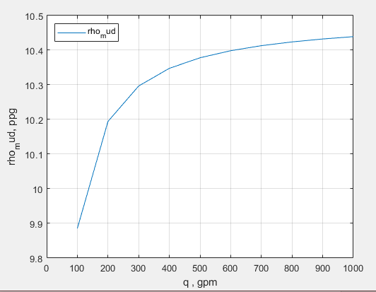
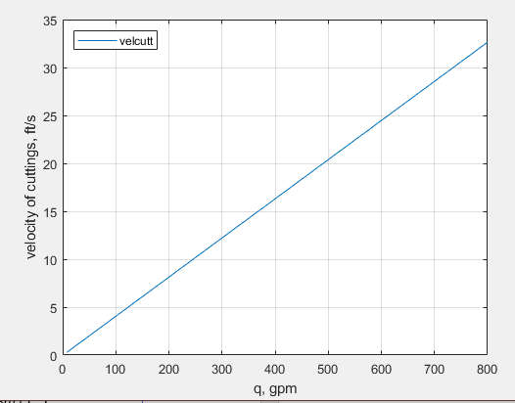
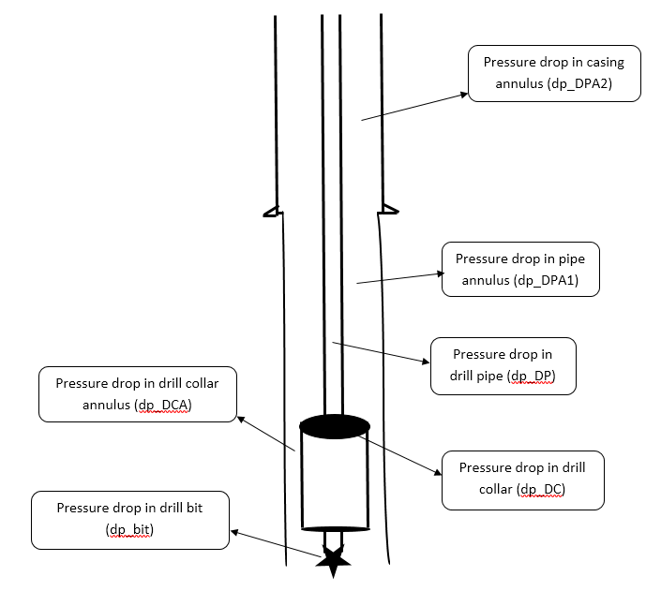
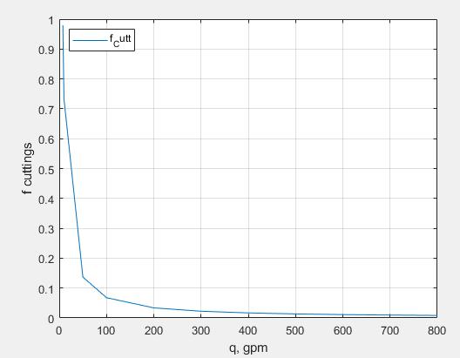
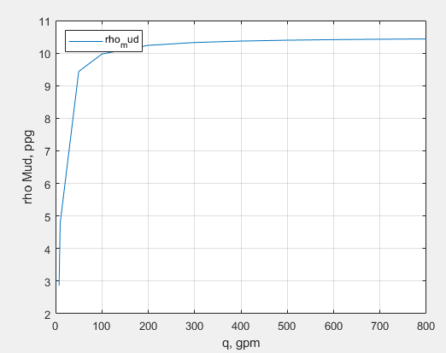
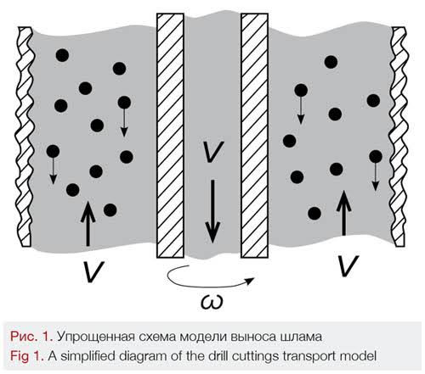
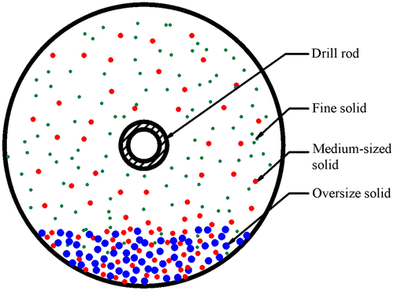
HYDRAULIC LOSSES AND CUTTINGS TRANSPORT
Muhammad Ammar Shahzad, Petroleum and Natural Gas Engineering. e204906@metu.edu.tr
Middle East Technical University, Northern Cyprus Campus
Introduction
Results & Discussions
Frictional pressure loss in energy balance equation is the most difficult and important term to evaluate because large viscous forces must be overcome to move the drilling fluids during drilling.
There are three rheological models to find pressure losses.
Newtonian model
Bingham plastic model
Power law model
Cuttings transport is another important factor which transports the rock cuttings from the drill bit up the annulus and to the surface. If the cuttings are not transported to the surface, the drilling stops.
Bingham plastic model
After the calculations for pressure loss, cuttings transport and mud density, the following plots were obtained for Bingham plastic model
Objectives
The objective is to find the hydraulic pressure loss occurring in the drill pipe, drill collar, drill bit, drill collar annulus, drill pipe annulus and casing annulus with changing flowrate.
To find the velocity of rock cuttings with changing flowrates.
To find the concentrations and the density of the mud with changing flowrates.
Power law model
Pressure loss in the well string
Conclusions
For Bingham plastic, the pressure drop for drill pipe and drill bit are high with increasing flowrate.
As we go from laminar to turbulent flow, there is an increase in the pressure drop.
The velocity of cuttings increase linearly with increasing flowrates.
Density of the mud increases when there is laminar flow because of rock cuttings being transported to the surface.
Cuttings Transport
Acknowledgements & References
Special thanks to Prof. Dr. Doruk Alp for his help and support in achieving the results for this project
References:
A.T. Bourgoyne Jr, K.K. Millheim, M.E. Chenevert and F.S. Young Jr. (1991). Applied Drilling Engineering.

